Slide 1


Improve your Azure productivity Using Visual Studio Code
Eldert Grootenboer

Slide 2



Eldert Grootenboer
@egrootenboer

Slide 3
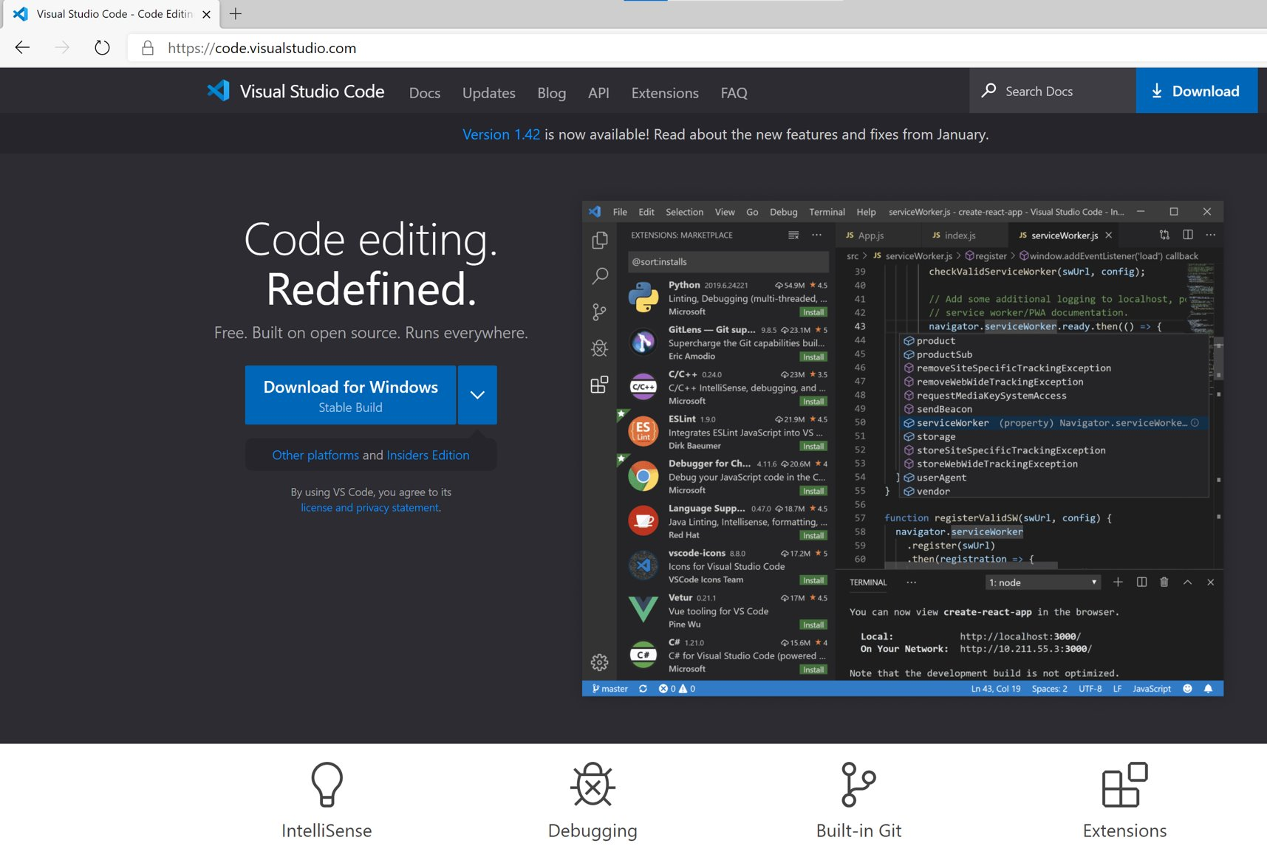
What is Visual Studio Code?

Slide 4
Visual Studio Code & Azure
One tool to rule them all
First class citizen
Adjust to your workflow

Slide 5

Demo time!

Slide 6
Functions
Develop and debug
Manage and monitor
Durable Functions Monitor
Notes:
Adjust parameter in Function code
Run Function locally
Send request using REST Client and explain plugin
Explain that same function is deployed in Azure
Show Functions blade in VS Code
Go through different options
Show how to use Logs -> Connect to log stream, to check streaming logs of DurableFunction_HttpStart
Show Durable Functions blade to show options with Durable Functions

Slide 7
Logic Apps
Browse and manage
Create deployment templates
Logic Apps on Functions runtime (preview)
Develop from Visual Studio Code
New editor
Notes:
Use Logic Apps blade in VS Code to show visualization of existing Logic App
Show response using 2-logic-apps.rest
Use same blade to update response statuscode in code behind
Show new response using 2-logic-apps.rest
Use same blade to show run history
Create ARM template for Logic App
Logic Apps Preview NOT in Codespaces, make sure storage emulator is started, and VS Code is running as Administrator
Use Logic Apps (Preview) blade to show new designer
Run Logic App (Preview) locally
Show overview

Slide 8
API Management
Manage your environment
Extract deployment templates
Test your APIs
REST Client
.vscode settings
Notes:
Show overview in API Management blade in VS Code
Test operation using blade
Add throttling policy using intellisense (rate-limit)
Debug policy
Extract ARM templates

Slide 9
ARM Templates
Intellisense and syntax highlighting
Snippets
Schema and parameter validation
Sorting
Extraxt variables and parameters
ARM Template Viewer
Notes:
Create new ARM template using snippet
Add storage account using snippet
Go through intellisense and syntax highlighting
Extract parameter for name
Extract variable for kind and display name
Sort variables
Create parameter file
Build bicep file (bicep build myfile.bicep)
Show ARM Visualizer with ARM template of API Management

Slide 10
GitHub Codespaces
Get started quickly
Same setup anywhere
Work locally or in a browser

Slide 11
Live Share
Real-time collaboration
Editing and debugging
Including live audio and text chat

Slide 12
Customize to your needs
JSON / XML
GitHub / Azure DevOps
Linting
Draw.io
Notes:
Search for Azure in extensions

Slide 13

Almost done…

Slide 14
Recap
Productivity
Extensions
Visual Studio Code ♥ Azure
Notes:
Focus on getting more productivity by using the right tool for the job
Extensions allow to customize to your needs
Use Visual Studio Code when working with Azure

Slide 15



Thank You!
@egrootenboer
eldert@eldert.net
https://www.linkedin.com/in/eldert-grootenboer
Notes:
Rustig spreken!

